Slide 1
FIN 3000
Chapter 8
Risk and Return:
Capital Asset Pricing Model
Liuren Wu
Notes:
FIN3000, Liuren Wu

Slide 2
Overview
Portfolio Returns and Portfolio Risk
  Calculate the expected rate of return and volatility for a portfolio of investments and describe how diversification affects the returns to a portfolio of investments.
Systematic Risk and the Market Portfolio
  Understand the concept of systematic risk for an individual investment and calculate portfolio systematic risk (beta).
The CAPM
  Estimate an investor’s required rate of return using capital asset pricing model.
FIN3000, Liuren Wu

Slide 3
8.1 Portfolio Returns and Portfolio Risk
By investing in many different stocks to form a portfolio, we can lower the risk without lowering the expected return.
The effect of lowering risk via appropriate portfolio formulation is called diversification.
By learning how to compute the expected return and risk on a portfolio, we illustrate the effect of diversification.
FIN3000, Liuren Wu

Slide 4
The Expected Return of a Portfolio
To calculate a portfolio’s expected rate of return, we weight each individual investment’s expected rate of return using the fraction of money invested in each investment.
Example 8.1 : If you invest 25%of your money in the stock of Citi bank (C) with an expected rate of return of -32% and 75% of your money in the stock of Apple (AAPL) with an expected rate of return of 120%, what will be the expected rate of return on this portfolio?
  Expected rate of return = .25(-32%) + .75 (120%) = 82%
FIN3000, Liuren Wu

Slide 5
Checkpoint 8.1
Calculating a Portfolio’s Expected Rate of Return
Penny Simpson has her first full-time job and is considering how to invest her savings. Her dad suggested she invest no more than 25% of her savings in the stock of her employer, Emerson Electric (EMR), so she is considering investing the remaining 75% in a combination of a risk-free investment in U.S. Treasury bills, currently paying 4%, and Starbucks (SBUX) common stock. Penny’s father has invested in the stock market for many years and suggested that Penny might expect to earn 9% on the Emerson shares and 12% from the Starbucks shares. Penny decides to put 25% in Emerson, 25% in Starbucks, and the remaining 50% in Treasury bills. Given Penny’s portfolio allocation, what rate of return should she expect to receive on her investment?
FIN3000, Liuren Wu

Slide 6
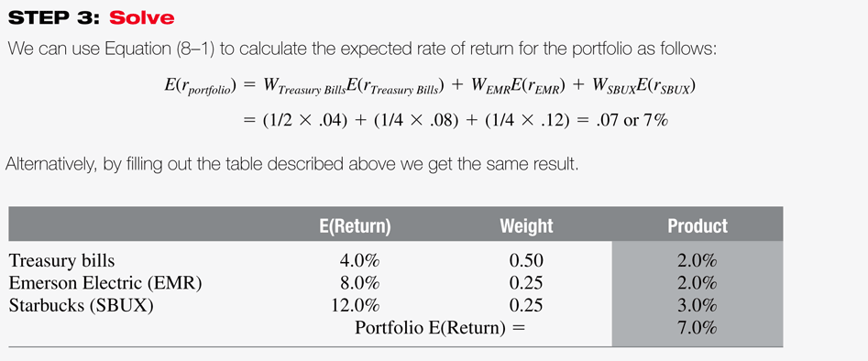

Checkpoint 8.1
FIN3000, Liuren Wu

Slide 7
Checkpoint 8.1: Check Yourself
Evaluate the expected return for Penny’s portfolio where she places 1/4th of her money in Treasury bills, half in Starbucks stock, and the remainder in Emerson Electric stock.
Answer: 9%.
FIN3000, Liuren Wu

Slide 8
Evaluating Portfolio Risk
Unlike expected return, standard deviation is not generally equal to the a weighted average of the standard deviations of the returns of investments held in the portfolio. This is because of diversification effects.
The diversification gains achieved by adding more investments will depend on the degree of correlation among the investments.
The degree of correlation is measured by using the correlation coefficient ( ).
FIN3000, Liuren Wu

Slide 9
Correlation and diversification
The correlation coefficient can range from -1.0 (perfect negative correlation), meaning two variables move in perfectly opposite directions to +1.0 (perfect positive correlation), which means the two assets move exactly together.
A correlation coefficient of 0 means that there is no relationship between the returns earned by the two assets.
As long as the investment returns are not perfectly positively correlated, there will be diversification benefits.
However, the diversification benefits will be greater when the correlations are low or negative.
The returns on most stocks tend to be positively correlated.
FIN3000, Liuren Wu

Slide 10
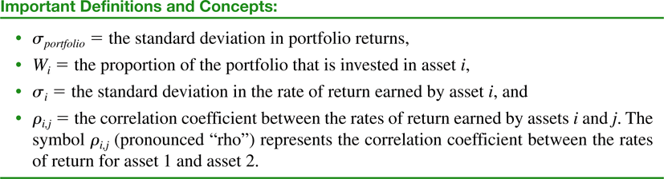
Standard Deviation of a Portfolio
For simplicity, let’s focus on a portfolio of 2 stocks:
FIN3000, Liuren Wu

Slide 11

Diversification effect
Investigate the equation:
  When the correlation coefficient =1, the portfolio standard deviation becomes a simple weighted average:
  If the stocks are perfectly moving together, they are essentially the same stock. There is no diversification.
  For most two different stocks, correlation is less than perfect (<1). Hence, the portfolio standard deviation is less than the weighted average. – This is the effect of diversification.
FIN3000, Liuren Wu

Slide 12
Example
Determine the expected return and standard deviation of the following portfolio consisting of two stocks that have a correlation coefficient of .75.
Portfolio | Weight | Expected Return | Standard Deviation
Apple | .50 | .14 | .20
Coca-Cola | .50 | .14 | .20
FIN3000, Liuren Wu

Slide 13
Answer
Expected Return = .5 (.14) + .5 (.14)= .14 or 14%
Standard deviation
= √ { (.5²x.2²)+(.5²x.2²)+(2x.5x.5x.75x.2x.2)}
  = √ .035= .187 or 18.7%
  Lower than the weighted average of 20%.
FIN3000, Liuren Wu

Slide 14
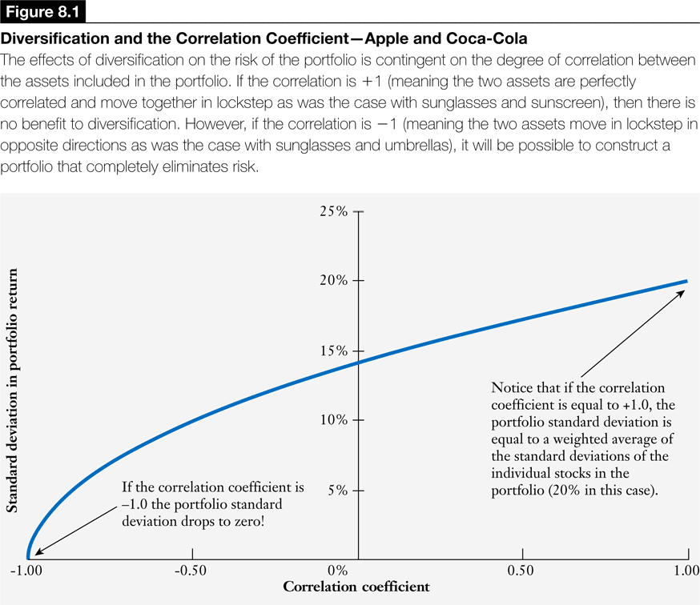
FIN3000, Liuren Wu

Slide 15
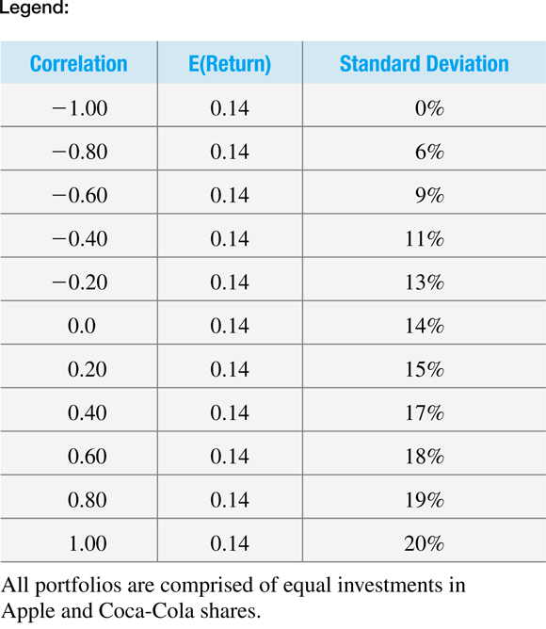
Portfolio return does not depend on correlation
Portfolio standard deviation decreases with declining correlation.
FIN3000, Liuren Wu

Slide 16
Checkpoint 8.2
Evaluating a Portfolio’s Risk and Return
Sarah plans to invest half of her 401k savings in a mutual fund mimicking S&P 500 ad half in an international fun.
The expected return on the two funds are 12% and 14%, respectively. The standard deviations are 20% and 30%, respectively. The correlation between the two funds is 0.75.
What would be the expected return and standard deviation for Sarah’s portfolio?
FIN3000, Liuren Wu

Slide 17
Checkpoint 8.2: Check Yourself
Verify the answer: 13%, 23.5%
Evaluate the expected return and standard deviation of the portfolio, if the correlation is .20 instead of 0.75.
FIN3000, Liuren Wu

Slide 18
Answer
The expected return remains the same at 13%.
The standard deviation declines from 23.5% to 19.62% as the correlations declines from 0.75 to 0.20.
The weight average of the standard deviation of the two funds is 25%, which would be the standard deviation of the portfolio if the two funds are perfectly correlated.
Given less than perfect correlation, investing in the two funds leads to a reduction in standard deviation, as a result of diversification.
FIN3000, Liuren Wu

Slide 19
8.2 Systematic Risk and Market Portfolio
It would be an onerous task to calculate the correlations when we have thousands of possible investments.
Capital Asset Pricing Model or the CAPM provides a relatively simple measure of risk.
CAPM assumes that investors choose to hold the optimally diversified portfolio that includes all risky investments. This optimally diversified portfolio that includes all of the economy’s assets is referred to as the market portfolio.
According to the CAPM, the relevant risk of an investment relates to how the investment contributes to the risk of this market portfolio.
FIN3000, Liuren Wu

Slide 20
Risk classification
To understand how an investment contributes to the risk of the portfolio, we categorize the risks of the individual investments into two categories:
  Systematic risk, and
  Unsystematic risk, or idiosyncratic risk
The systematic risk component measures the contribution of the investment to the risk of the market. For example: War, hike in corporate tax rate.
The unsystematic risk is the element of risk that does not contribute to the risk of the market. This component is diversified away when the investment is combined with other investments. For example: Product recall, labor strike, change of management.
FIN3000, Liuren Wu

Slide 21
Systematic versus Idiosyncratic Risk
An investment’s systematic risk is far more important than its unsystematic risk.
If the risk of an investment comes mainly from unsystematic risk, the investment will tend to have a low correlation with the returns of most of the other stocks in the portfolio, and will make a minor contribution to the portfolio’s overall risk.
FIN3000, Liuren Wu

Slide 22
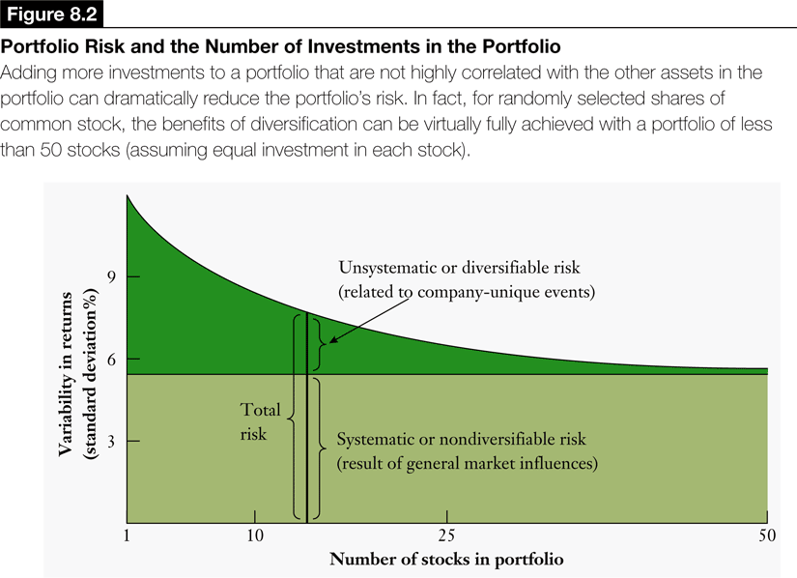
FIN3000, Liuren Wu

Slide 23
Diversification and Systematic Risk
Figure 8-2 illustrates that as the number of securities in a portfolio increases, the contribution of the unsystematic or diversifiable risk to the standard deviation of the portfolio declines.
Systematic or non-diversifiable risk is not reduced even as we increase the number of stocks in the portfolio.
Systematic sources of risk (such as inflation, war, interest rates) are common to most investments resulting in a perfect positive correlation and no diversification benefit.
Large portfolios will not be affected by unsystematic risk but will be influenced by systematic risk factors.
FIN3000, Liuren Wu

Slide 24
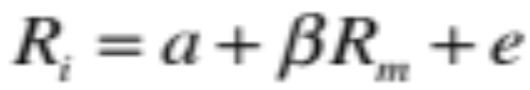
Systematic Risk and Beta
Systematic risk is measured by beta coefficient, which estimates the extent to which a particular investment’s returns vary with the returns on the market portfolio.
In practice, it is estimated as the slope of a straight line (see figure 8-3):
Beta could be estimated using excel or financial calculator, or readily obtained from various sources on the internet (such as Yahoo Finance and Money Central.com)
FIN3000, Liuren Wu

Slide 25
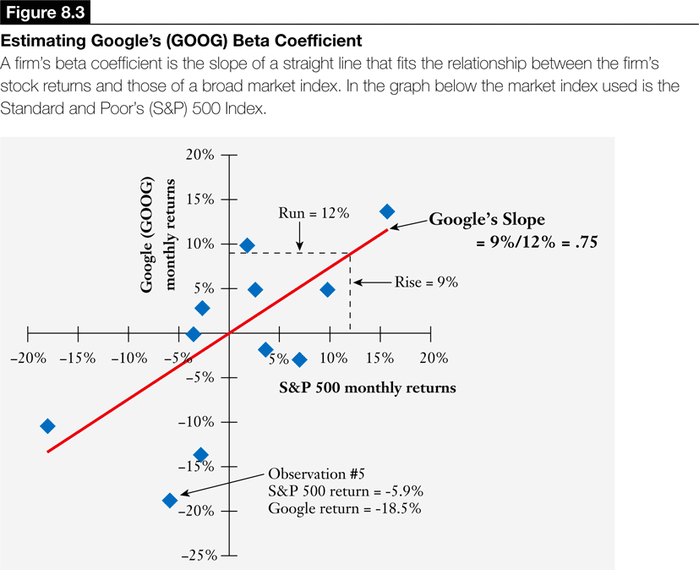
FIN3000, Liuren Wu

Slide 26
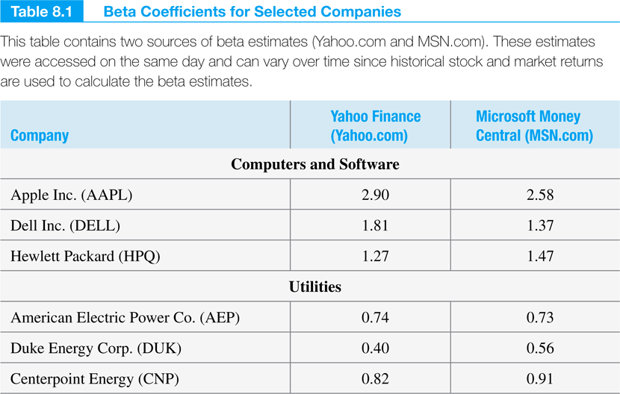
Utilities companies can be considered less risky because of their lower betas.
FIN3000, Liuren Wu

Slide 27
Portfolio Beta
The beta of a portfolio measures the systematic risk of the portfolio and is calculated by taking a simple weighted average of the betas for the individual investments contained in the portfolio.
Example 8.2 Consider a portfolio that is comprised of four investments with betas equal to 1.5, .75, 1.8 and .60. If you invest equal amount in each investment, what will be the beta for the portfolio?
  Portfolio beta= 1.5*(1/4)+.75*(1/4)+1.8*(1/4)+.6*(1/4) =1.16
FIN3000, Liuren Wu

Slide 28
8.3 The CAPM
CAPM also describes how the betas relate to the expected rates of return that investors require on their investments.
The key insight of CAPM is that investors will require a higher rate of return on investments with higher betas. The relation is given by the following linear equation:
R_{market} is the expected return on the market portfolio
R_{f} is the riskfree rate (return for zero-beta assets).
FIN3000, Liuren Wu

Slide 29
Example
Example 8.2 What will be the expected rate of return on AAPL stock with a beta of 1.49 if the risk-free rate of interest is 2% and if the market risk premium, which is the difference between expected return on the market portfolio and the risk-free rate of return is estimated to be 8%?
AAPL expected return = 2% + 1.49*8% = 13.92%.
FIN3000, Liuren Wu

Slide 30
Checkpoint 8.3: Check Yourself
Estimate the expected rates of return for the three utility companies, found in Table 8-1, using the 4.5% risk-free rate and market risk premium of 6%. Use beta estimates from Yahoo:
  AEP = 0.74,DUK = 0.40,CNP = 0.82.
FIN3000, Liuren Wu

Slide 31
Solution
Beta (AEP) = 4.5% + 0.74(6%) = 8.94%
Beta (DUK) = 4.5% + 0.40(6%) = 6.9%
Beta (CNP) = 4.5% + 0.82(6%) = 9.42%
The higher the beta, higher is the expected return.
FIN3000, Liuren Wu

